Slide 1
New SPOT Program
Customer Tutorial

Slide 2
General Purpose/Requirements
The purpose of the New Spot Webpage is to build upon the functionality of the existing spot page, and incorporate these new general requirements:
One consolidated web presence
Google mapping interface
All hazard applicable
Relational database

Slide 4
Front Page Changes
User now accesses ONE national page.
Eliminates need for 122+ start pages
Ensures correct office gets request
User can monitor areas covering multiple forecast areas

Slide 6
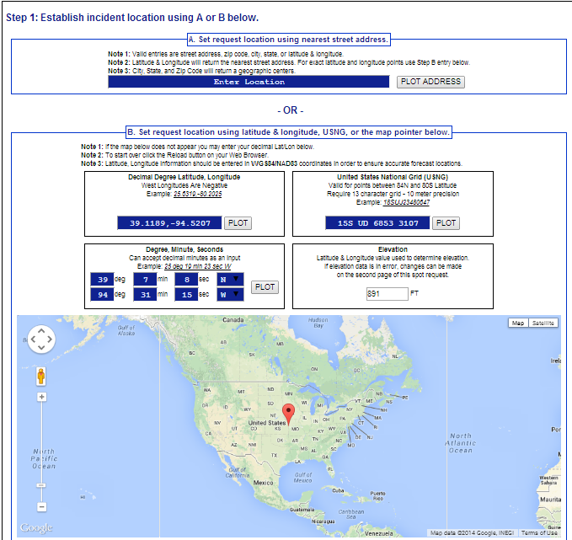
New Submit Spot Request

Slide 7
Incident Location
Uses Google Map functions for the user to drag and drop marker to spot location, including zoom capability.
Three geographic location boxes will prefill based on placement of marker:
Lat/Lon – Decimal Degrees
Lat/Lon – Deg/Min/Sec
U.S. National Grid Coordinates
The user can also enter this information manually using format of choice.
Other two boxes will prefill, and map will zoom to help refine location if needed.
Disclaimer statement (Note 3) alerts user that if the lat/lon is not entered in WGS 84/NAD 83 the location of the spot may be incorrect.

Slide 8
Importance of Incident Location
Important for customer to get location right, so the right forecast office gets the request.
The new Spot web page will now determine which forecast office is responsible for the request.
Fire Weather Area of Responsibility (AOR) boundaries are used for fire type requests.
County Warning Area (CWA) boundaries are used for all other requests.

Slide 9
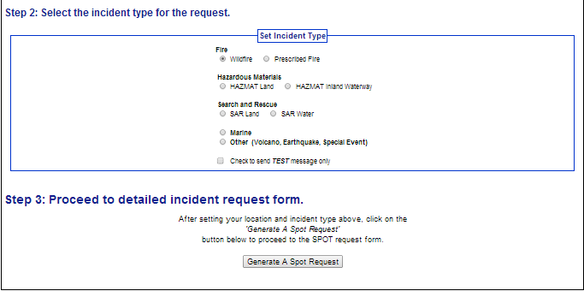
New Submit Spot Request

Slide 10
Submit Spot Request Changes
New step is to select the incident type like “Wildfire” or “HAZMAT Land”.
Selection is important because it determines what weather elements will be offered to the customer on the next page of the request form.
This is a major enhancement over the old page. For example, marine elements are not needed for wildfire requests.

Slide 11
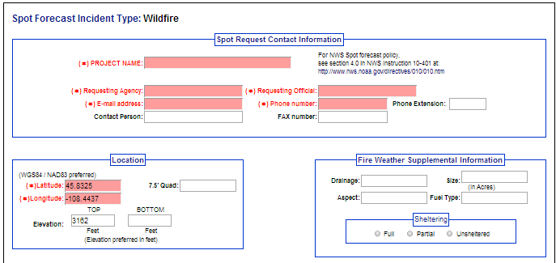
Submit Spot Request - Page 2 (top)

Slide 12
Submit Spot Request Notes
When the Submit button is pressed, page two of the form appears.
This form is tailored by the responsible forecast office per requested incident type. A WFO can configure the offered forecast formats, time steps, and forecast elements.
Required fields are highlighted in red.
Top section added a field for email address.
The Fire Weather Supplemental Information section shown in the example will disappear for non-fire requests.

Slide 13
Spot Request
Required fields are highlighted in red.
There is a “Deliver Forecast" time and a "Forecast Starting” time.
Note - "Forecast Starting” time can only be within 24 hours of “Deliver Forecast“ time.
To request recurring spot forecasts, the customer must contact the WFO.
A WFO can configure the offered forecast formats, time steps, and forecast elements. Therefore, the forecasts formats and elements may not be consistent for all locations.

Slide 14
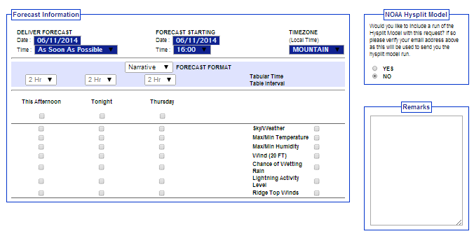
Submit Spot Request - Page 2 (middle)

Slide 15
Submit Spot Request Notes
Weather Elements requested section has been considerably revamped.
Forecast Deliver date/time has been added. Users can get forecasts ASAP or enter in when the forecast is needed.
An STQ will be created for a request when the Forecast Deliver time is within the next 6 hours.
Ignition date/time has been replaced with the Forecast Start date/time.
Note - "Forecast Starting” time can only be within 24 hours of “Deliver Forecast“ time.
The first forecast period will be dynamic based on the Forecast Start Time. For example “today”, “tonight”, “this afternoon”, etc.

Slide 16
Submit Spot Request Notes
Customer can now select the following (dependent on what responsible WFO offers):
Forecast format - Narrative only, both Narrative and Tabular, and Tabular only
Tabular time interval for each period (if applicable)
Each incident type has a required minimum set of forecast elements that must be offered
Additional elements may be offered by the WFO and can vary based on incident type
Easier to select/deselect weather elements by period and by weather element.
Added the ability to request the Hysplit model output.

Slide 17
HYSPLIT Feature
There is a radio button on the Spot Request page to request a HYSPLIT Trajectory run.
The HYSPLIT model will run per its current defaults in the current spot webpage.
NAM 12
Static levels of 500, 1500 and 3000 AGL
Trajectory run based on ignition time only
The output is emailed to the address input at the top of the request form.
There may be more options available to customize these runs in the future.

Slide 18
Fire Forecast Elements
Fire Core elements (selectable by the user by forecast period):
Sky/Weather
Max/Min Temperature
Max/Min Humidity
Wind (20 FT)
Prescribed Fire Core elements (selectable by the user by forecast period):
Sky/Weather
Max/Min Temperature
Max/Min Humidity
Start Temperature
Start Humidity
Wind (20 FT)
Start Winds
*NOTE: For Fire and Prescribed Fire, regardless of what the user selects, GFE formatters will produce forecasts of Sky/Weather, Max/Min Temperature, Max/Min Relative Humidity, and Winds for 3 periods as required by NWS Directive 10-401 4.3.2. All other elements are selectable by the user by forecast period.

Slide 19
Hazardous Materials Elements
HAZMAT Land Core Elements
Sky/Weather
Max/Min Temperature
Max/Min Humidity
Wind
Dew point
Probability of precipitation
HAZMAT Inland Waterway Core Elements
Sky/Weather
Max/Min Temperature
Max/Min Humidity
Wind
All elements are selectable by the user by forecast period.

Slide 20
Search and Rescue Elements
SAR Land Core Elements
Max/Min Temperature
Max/Min Humidity
Wind
Dew point
Probability of precipitation
SAR Water Core Elements
Sky/Weather
Max/Min Temperature
Max/Min Humidity
Wind
Significant Wave Height
All elements are selectable by the user by forecast period.

Slide 21
More Elements
Marine Core Elements
Sky/Weather
Max/Min Temperature
Max/Min Humidity
Wind
Significant Wave Height
“Other” Core Elements
Sky/Weather
Max/Min Temperature
Max/Min Humidity
Wind
All elements are selectable by the user by forecast period.

Slide 22
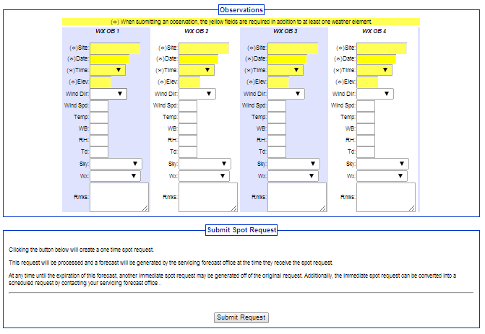
Submit Spot Request - Page 2 (bottom)

Slide 23
Submit Spot Observation Notes
Observation entry is a bit more standardized with the use of dropdown menus.
Pressing the submit button will send a STQ notification message to the WFO just like the old web page did.

Slide 25
New Monitor Spot Forecasts

Slide 26
Monitor Spot Forecasts Map
Significant overhaul of this page.
In the current Spot, every Forecast Office has their own page. In the new Spot, each user can set the area they want to monitor by zooming. The monitor area can include areas of responsibility of multiple Forecast Offices.
Map uses Google API, so anyone can zoom in and out/shift map.

Slide 27
Monitor Spot Forecasts Table
Current Spot only lists requests on one calendar day.
New Spot Monitor has all incidents on one page. When an incident is finished, then the incident will be closed by the forecast office.
Closing an incident will move all information and forecasts into an archive.

Slide 28
Monitor Spot Forecasts Notes
On the current Spot, multiple requests for the same incident would clutter up the display with multiple lines.
On the new Spot, there will only be one line per incident. Only the latest forecast will be available.
Requests can be corrected from the Monitor Spot Forecasts page via “Change Request.”

Slide 29
Monitor Spot Forecast – Submit Obs
A “Submit Obs” link has been added for each incident in the table in the “Action” column.
This allows customers to enter observations for an incident without having to submit a new request.
All observations for the incident will be databased and available to the forecaster.
Forecasters will not need to look at multiple requests to analyze observations.

Slide 30
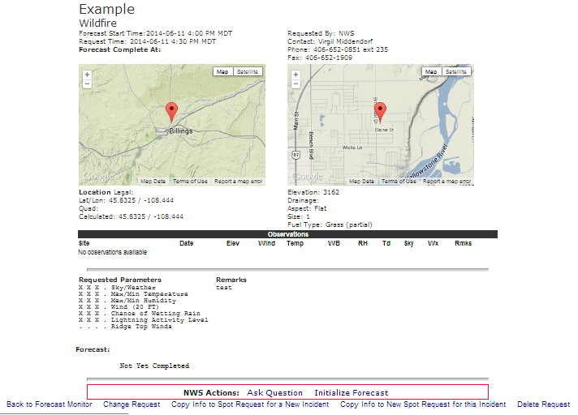
New Spot Forecast Page
NWS Actions will appear
for responsible WFO (or back-up)
only. These will not appear for customers.

Slide 31
Spot Forecast Page Notes:
Maps now use Google API interface.
All Observations submitted for an incident will be listed on the Spot Forecast page.

Slide 32
New Forecast Page
*NEW!
*NEW!

Slide 33
Forecast Page – Immediate Forecast Update
New Action: “Request Immediate Forecast Update” link on bottom of forecast page.
If a customer realizes that the forecast is not representative of current conditions, then they would click this link to get an immediate updated forecast.
If an NWS forecaster realizes the forecast is not representative or will become unrepresentative, they would click this link to start the process of updating the forecast.

Slide 34
Forecast Page – Immediate Forecast Update
The customer, not the NWS forecaster, will be allowed to edit the information related to the request.
There will be, however, an opportunity to enter in new observations. If the customer realizes that the forecast is off, then it would be nice to submit an observation that would help the NWS create a new forecast.

Slide 35
Forecast Page – Copy Info
There are now 2 different “Copy Info” options:
Copy Info into Spot Request for New Incident
Customers use this link to retain all of the their contact information for a specific incident type, but request a spot for a new and separate incident.
Copy Info into New Spot Request for this Incident
The customer will use this link to get another forecast for the same incident. Unlike “Request Immediate Forecast Update”, the customer will get Page 2 of the request process. Weather elements can be adjusted and the forecast delivery date/time can be changed, etc.
This allows customers to easily schedule the next needed forecast for an incident without having to re-enter most of the information.
Allows new observations submitted to remain with the request.
The lat/lon of the incident cannot be changed with this option.

Slide 36
Experimental Service Comments
Comments on the New Experimental Spot Webpage are being collected at:
www.nws.noaa.gov/survey/nws-survey.php?code=SPOTWEBPAGE
from June 1 – December 31, 2015.

Slide 37
Additional Requirements are Being Considered for Future Versions of the Spot Webpage:
Add the ability to email a copy of the forecast.
Subset distinction of prescribed fire (i.e. pile burns, broadcast burns)..The idea is that this distinction would be made on the second page after the user selects prescribed fire.
Build a web interface to add an element to the optional list of forecast elements in the CMS database.
Have the spot program be connected with the radar and lightning data sets (via AWIPS) so that forecasters are alerted when thunderstorms approach the spot request site.
Add the ability to select different models and trajectory levels for the HYSPLIT trajectory runs.
Add the ability to select particular elevation levels for specific weather elements to help reduce the elements list (winds aloft, ridgetop winds, mid-level Haines Index, etc.)

